Slide 1
ToDo
Literature review about memory safety in unsafe Rust
Evans, Ana Nora, Bradford Campbell, and Mary Lou Soffa. "Is Rust used safely by software developers?." 2020 IEEE/ACM 42nd International Conference on Software Engineering (ICSE). IEEE, 2020.
Bae, Yechan, et al. "Rudra: Finding Memory Safety Bugs in Rust at the Ecosystem Scale." Proceedings of the ACM SIGOPS 28th Symposium on Operating Systems Principles. 2021.
Fuzzing Rust Programs

Slide 2
Preliminary: What is Rust?

Slide 3
Rust’s Competing Goals
Safety
Memory safety
Data-race freedom
Efficiency
Suitable for low-level and real-time apps
As fast as C

Slide 4
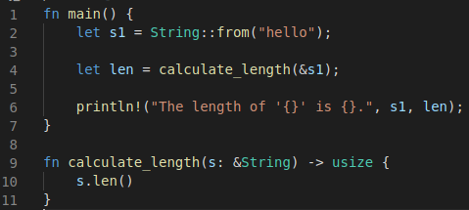
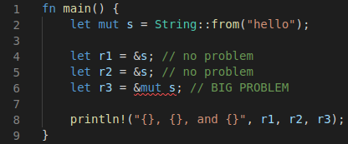


Why Rust Programs are Memory Safe?
No raw pointer dereferencing, Automatic memory release, and Enforced null checking
Using ownership and lifetime
Aliasing xor Mutability
(using optional value)
The variable s1 own the String value “hello”.
The variable s own the reference of the String value “hello”.
$≈$read-only pointer
The reference value is dropped after the line because s’ lifetime is end.
$≈$memory release
s is the owner of the value
However, the value “hello” is not dropped at that time because the variable s1 (owner of “hello”) is still alive.
by returning the value
The ownership of the value s.len() is transferred to the variable len
The variable s own the String value “hello” and it is mutable.
More than two (read-only) references are allowed.
No mutable reference is allowed if there is any (whether mutable or not) reference.

Slide 5
How Rust Programs are as Fast as C Programs?
Compile time lifetime checking
No garbage collection

Slide 6
Unsafe Rust
Allow more system friendly operations such as raw pointer dereferencing
Contain variants that Rust compiler cannot statically validate
Pass safety responsibility to programmers

Slide 7
Five Features of Unsafe Rust (1/3)
Dereference a raw pointer
Call an unsafe function or method
Access or Modify a mutable static variable
Implement an unsafe trait
Access fields of a union

Slide 8
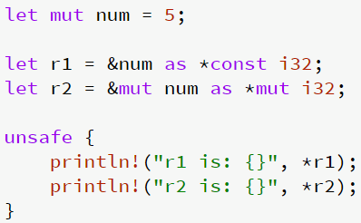
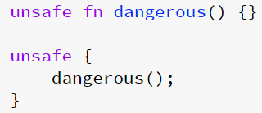
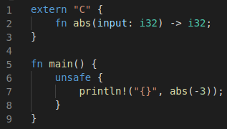
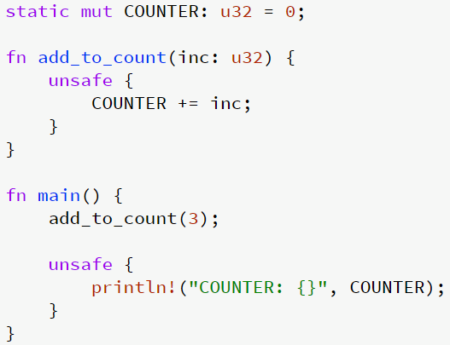
Five Features of Unsafe Rust (2/3)
Safe declarations of raw pointer references
Dereference a raw pointer
Declare a raw pointer reference itself is safe
Call an unsafe function or method
Access or Modify a mutable static variable
Unsafe dereferences of raw pointer references
External codes are always unsafe.
Static (global) variable is visible for any location.
Thus, data-race freedom is not guaranteed.

Slide 9
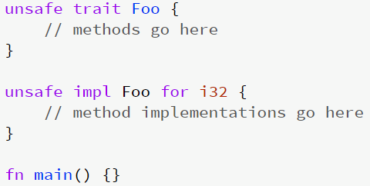

Five Features of Unsafe Rust (3/3)
Implement an unsafe trait
Access fields of a union: mainly for compatibility to C union type
$≈$interface in java

Slide 10
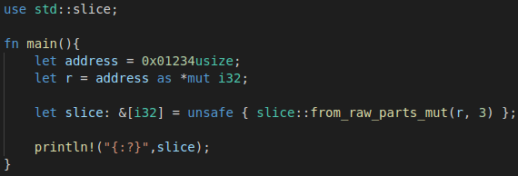
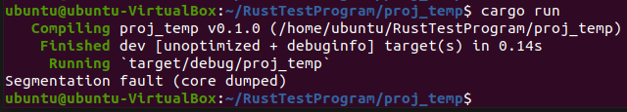
An Example Crash in an Unsafe Rust Program
Raw pointer reference dereferencing
No guarantee about the validity of contents at the pointer r which induces seg-fault

Slide 11
Is Rust Used Safely by Software Developers?
Evans, Ana Nora, Bradford Campbell, and Mary Lou Soffa.
University of Virginia
ICSE 2020

Slide 12
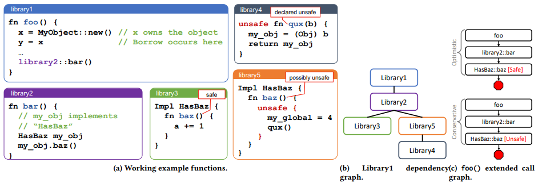
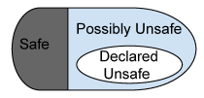
How Much Unsafe Codes are Used in Rust Programs?
Not only declared unsafe codes but also possibly unsafe codes
Functions in libraries
Dependency graph of the libraries
Function annotation taxanomy

Slide 13
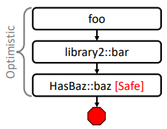
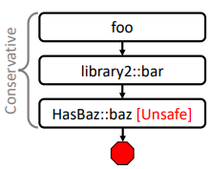
Extended Function Call Graph Analysis
To identify safe, declared unsafe, and possibly unsafe functions
two versions of call graphs: optimistic and conservative by considering polymorphism
Functions in libraries

Slide 14
Research Questions
How much Rust codes are unsafe?
RQ1: How much declared unsafe?
RQ2: How much possibly unsafe?
How developers use unsafe codes?
RQ3: What Unsafe Rust operations are used?
RQ4: What type of unsafe functions are called?
RQ5: Does the use of Unsafe Rust change over time?
RQ6: Why do Rust developers use unsafe?

Slide 15
Data Selection
13,096 crates from crates.io
Excluding crates that are not compiled (30% of the total registered crates)
Most Downloaded: a subset of 462 top downloaded crates from crates.io
Servo (approximately 50 crates)
As “higher quality” crates

Slide 16
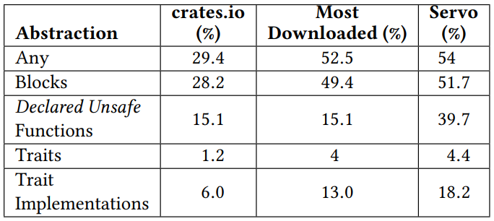
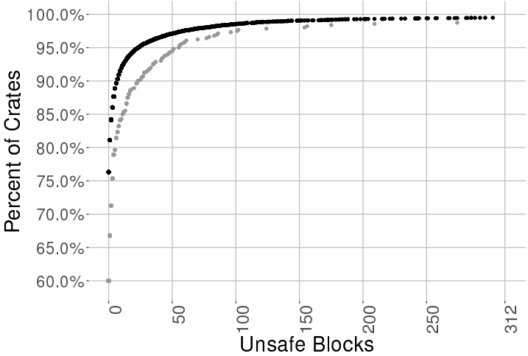
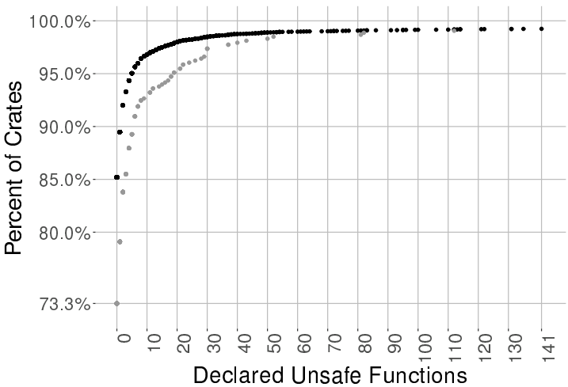
RQ1: How much declared unsafe?
Count the number of declared unsafe blocks, functions, traits, and traits implementations in each crates
crates.io
Most Down.
Percentage of Rust crates with Unsafe Rust based on abstraction type
Cumulative distribution of unsafe codes

Slide 17
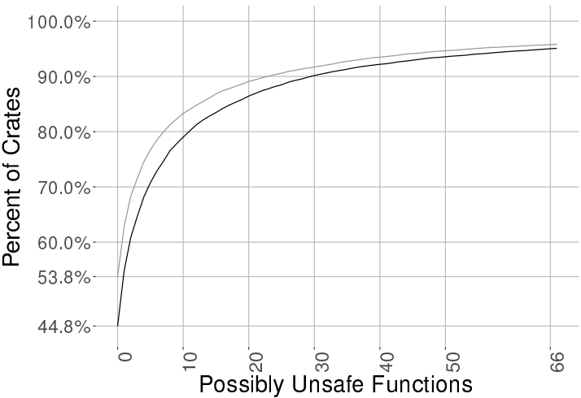
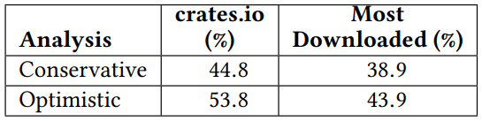
RQ2: How much possibly unsafe?
Less than 1/3 crates directly use unsafe.
Over half of crates use unsafe codes somewhere in the aggregate code
optimistic
conservative
Percentage of crates with only safe functions
Possibly unsafe functions distribution of all crates

Slide 18
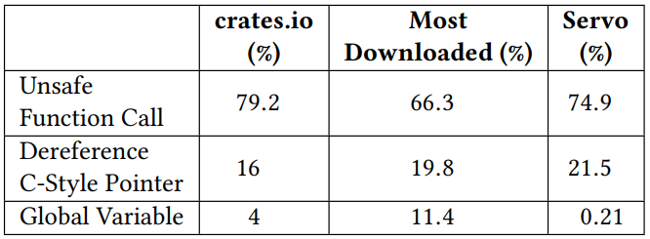
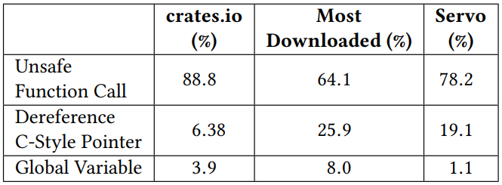
RQ3: What Unsafe Rust operations are used?
Distribution of unsafe operations in a data set
Results of crates that have more than 1% of unsafe operations
Unsafe operations in unsafe blocks
Unsafe operations in unsafe functions

Slide 19
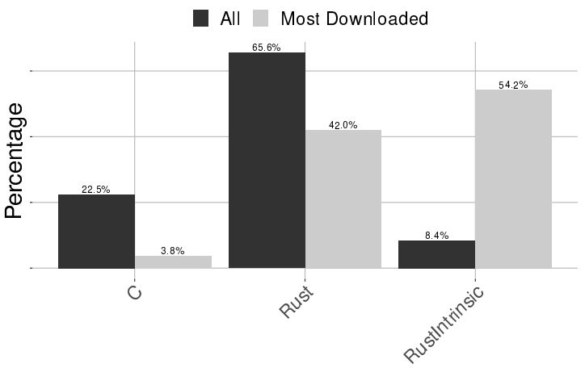
RQ4: What type of unsafe functions are called?
Three types of unsafe functions
extern C functions, declared Rust functions, and Rust Intrinsic

Slide 20
Discussion
No analysis about whether the unsafe codes are “actually” unsafe
Higher portion of (possibly) unsafe rust does not mean lower safety.
Using unsafe itself does not induce a crash.

Slide 21
Rudra: Finding Memory Safety Bugs in Rust at the Ecosystem Scale.
Yechan Bae, Youngsuk Kim, Ammar Askar,
Jungwon Lim, and Taesoo Kim
Georgia Institute of Technology
SOSP 2021

Slide 22
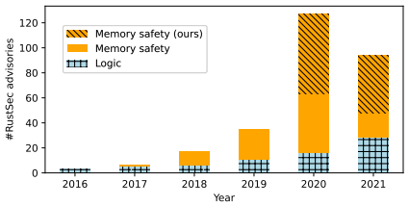
Does Unsafe Rust Codes Actually Induce Memory Safety Bugs?
Find three important bug patterns in Unsafe Rust
Propose two scalable static analysis algorithms (as RUDRA) to find the patterns
Detect 264 new memory safety bugs in Rust ecosystem
Which are more than half (51.6%) of the known memory bugs in RustSec since 2016
Memory safety bugs that RUDRA found

Slide 23
Three Mem Safety Bug Patterns
Panic safety bug
Higher-order safety invariant bug
Propagating Send/Sync in generic types bug
Which are hard to reasoning by traditional testing due to
Compiler generated codes (i.e., panic safety bug)
Limitation of Rust type system (i.e., higher-order safety invariant bug)
Manual trait implementation (i.e., propagating Send/Sync in generic types bug)

Slide 24
Fuzzing Rust Programs

Slide 25
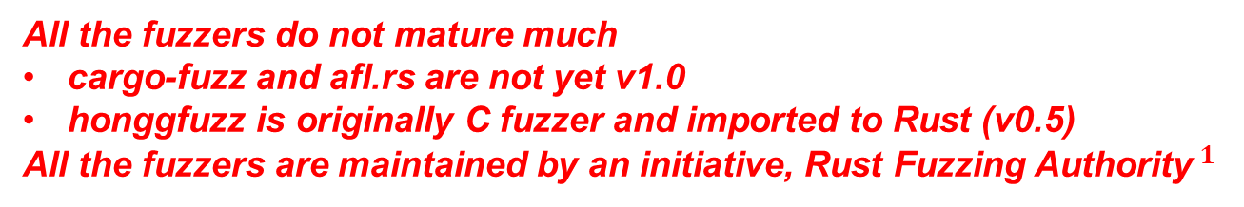
Available Fuzzers for Rust
cargo-fuzz: Fuzzing Rust programs with libFuzzer
afl.rs: Fuzzing Rust programs with AFL++
honggfuzz-rs: based on honggfuzz, developed and maintained by Google (not an official product)
Need fuzzing harness
All the fuzzers do not mature much
cargo-fuzz and afl.rs are not yet v1.0
honggfuzz is originally C fuzzer and imported to Rust (v0.5)
All the fuzzers are maintained by an initiative, Rust Fuzzing Authority$^{1}$
1. https://github.com/rust-fuzz

Slide 26
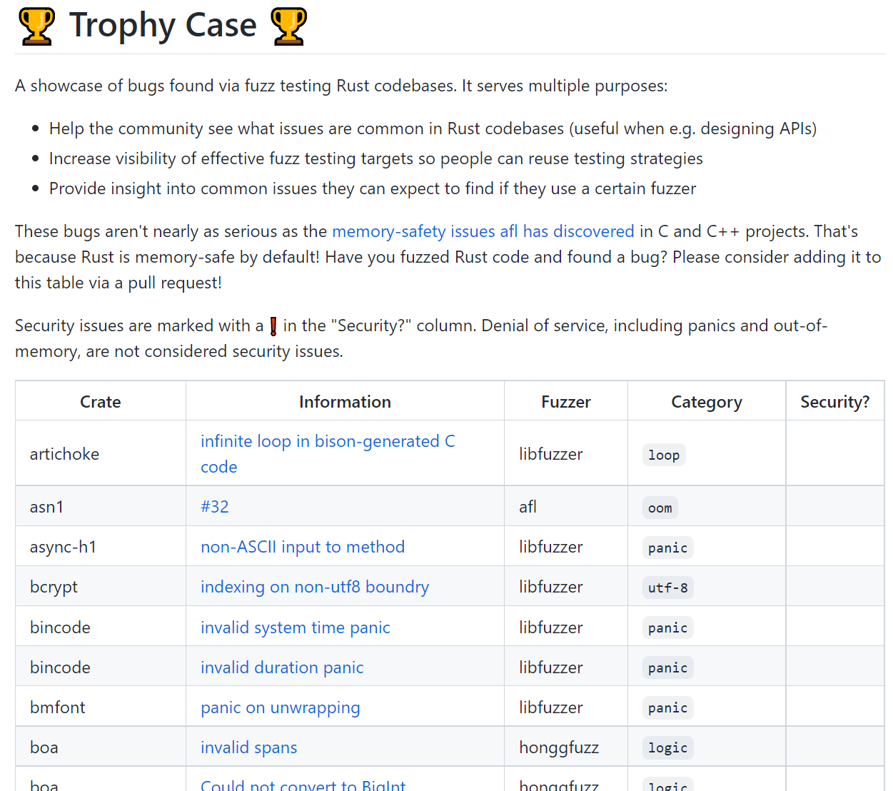
Available Target Rust Programs
From “trophy case” of Rust Fuzzing Authority
Trophy case from rust-fuzz

Slide 27
Next ToDo
Analysis about the memory safety bugs induced by unsafe codes
Fuzzing Rust Programs

Slide 28
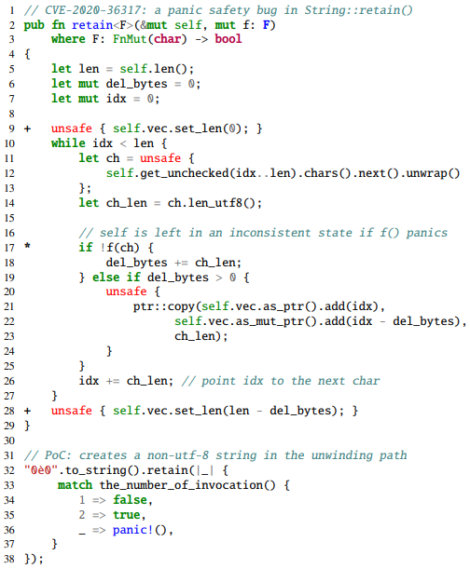
Panic Safety Bug

Slide 29
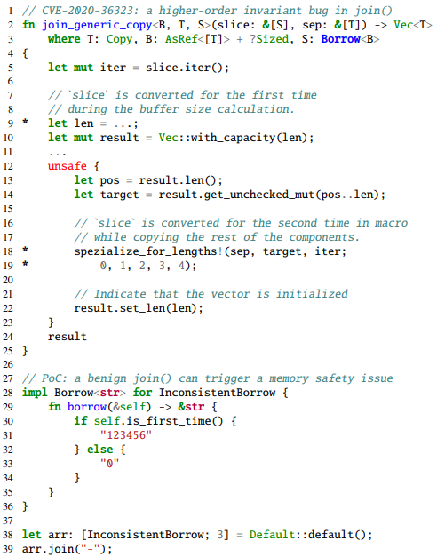
Higher-order Safety Invariant Bug

Slide 30
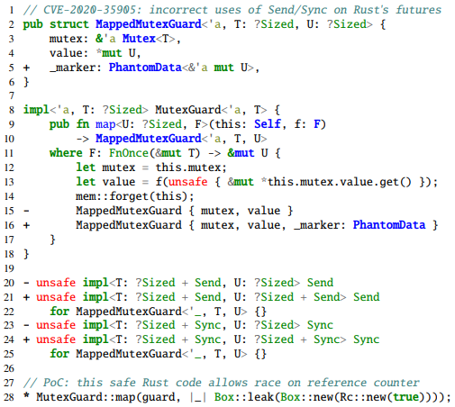
Propagating Send/Sync in Generic Types Bug

